Slide 1

Humanistic Research &
Graduate Education
Humanities Division, Social Sciences, Divinity

Slide 2

Reviewed Departments
Color Code
Other Humanistic Fields
Humanities Division
Cinema and Media Studies
Classics
Comparative Literature
East Asian Languages and Civilizations
English Language and Literature
Germanic Studies
Linguistics
Middle Eastern Studies
Music
Philosophy
Romance Languages and Literatures
Slavic Languages and Literatures
South Asian Languages and Civilizations
Theatre and Performance Studies
History
Anthropology
Sociology
Haris
Crown
Divinity
Unverified
Verification In Process
Information Verified

Slide 3
Doctoral Admissions
Humanistic vs. STEM

Slide 4
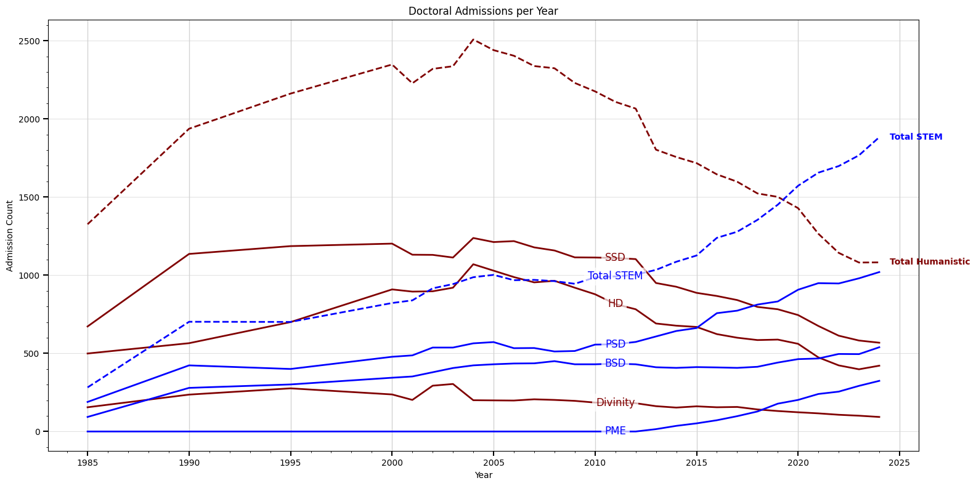
Source: Registrar Office, Autumn Quarter, Courtesy of Cliff Ando
Notes:
Source: Registrar Office, courtesy of Cliff Ando

Slide 5
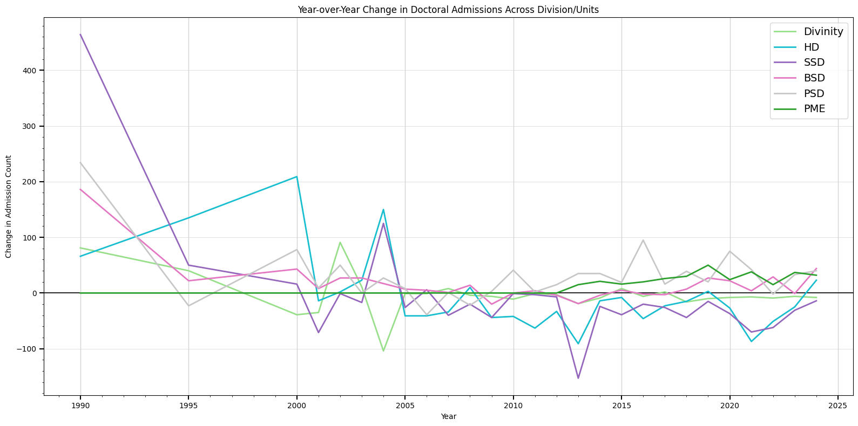

Slide 6
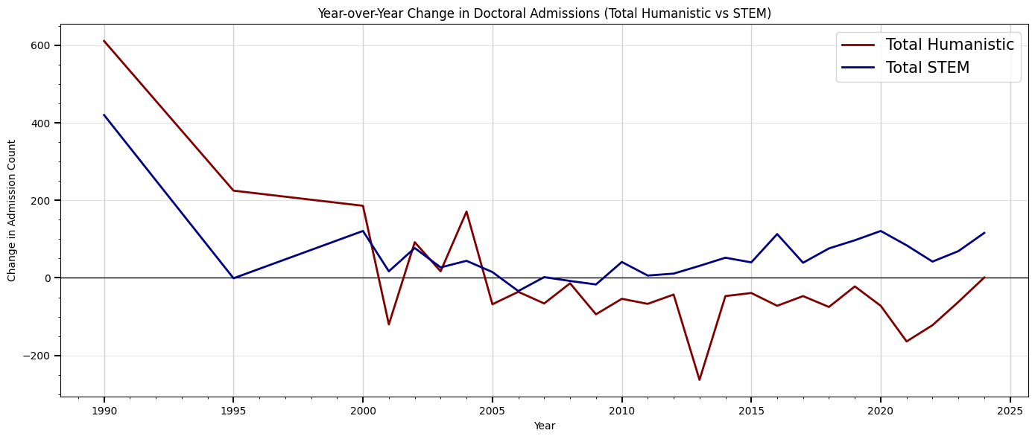

Slide 7
Doctoral Admissions
Humanistic Fields in Comparison

Slide 8
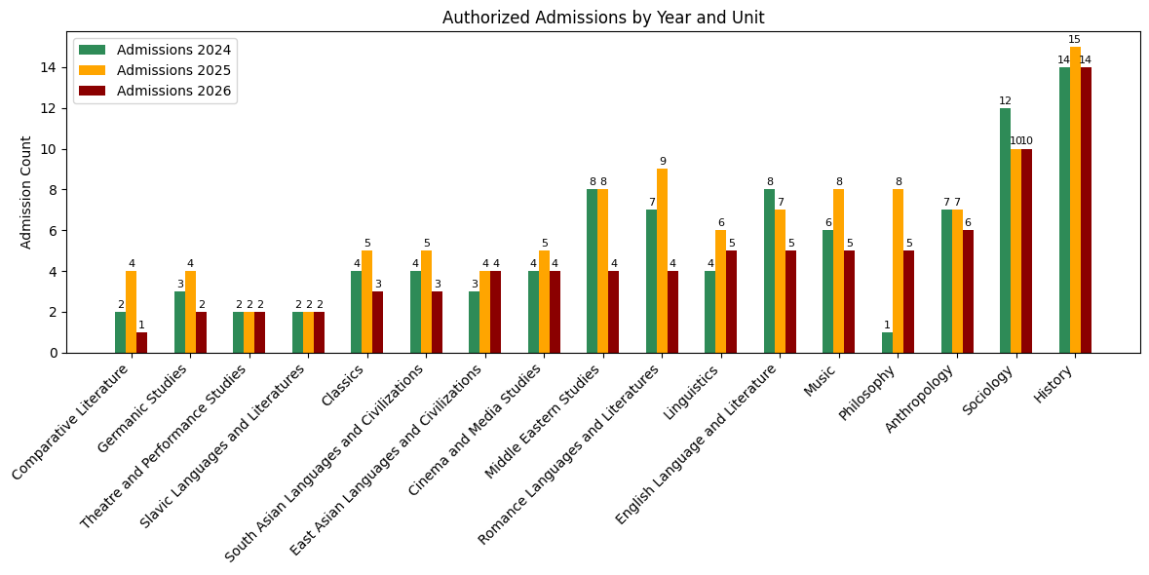
2024 Admission: Mean = 5.35, Median = 4.00
2025 Admission: Mean = 6.41, Median = 6.00
2026 Admission: Mean = 4.65, Median = 4.00

Slide 9
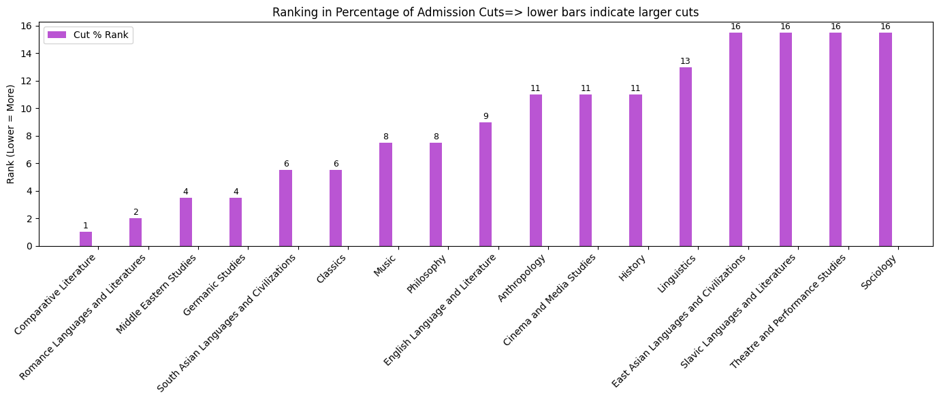

Slide 10
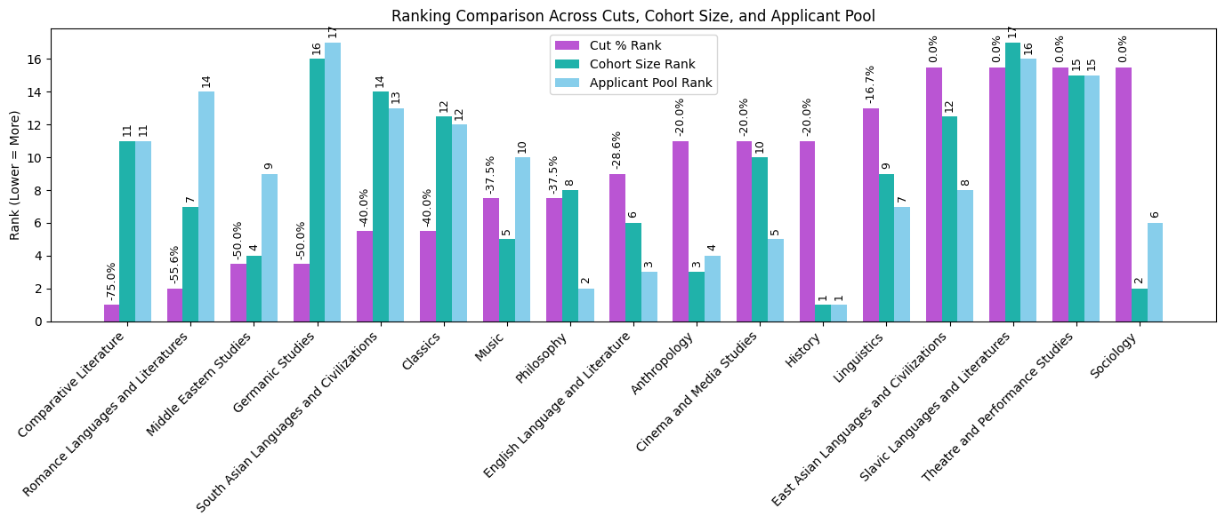
Admission Statistics

Slide 11
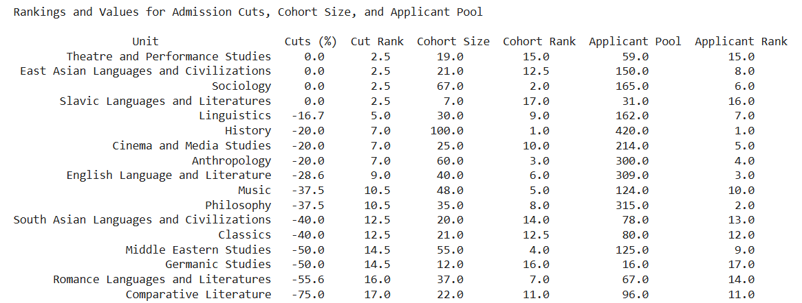

Slide 12
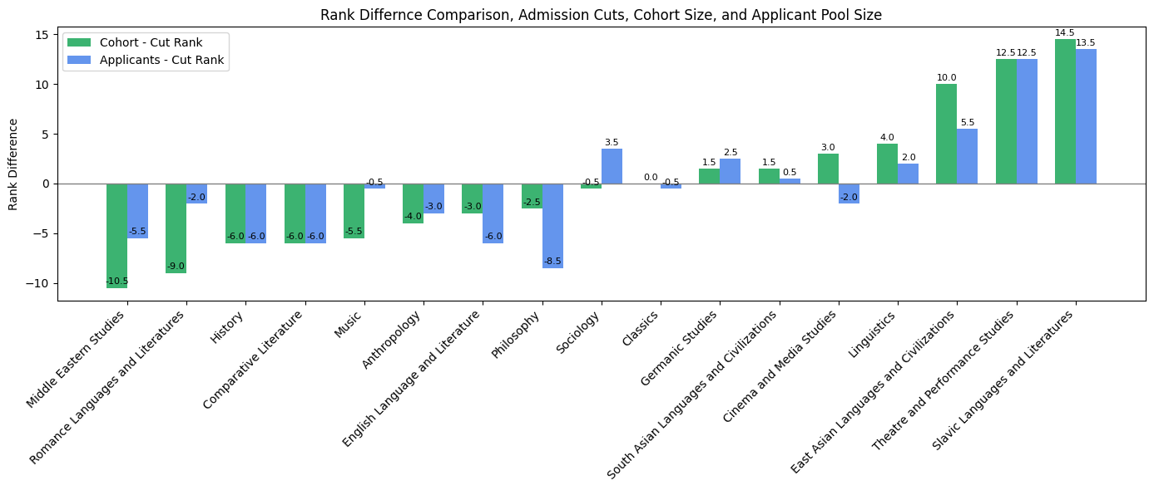

Slide 13
Personnel & Support

Slide 14
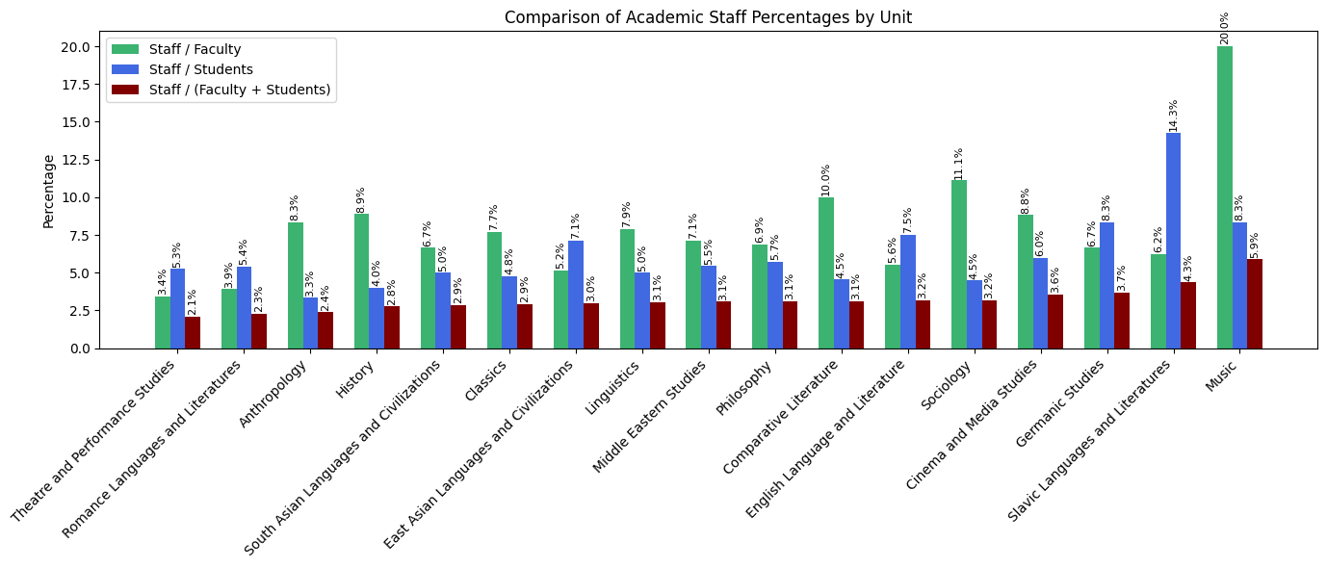

Slide 15
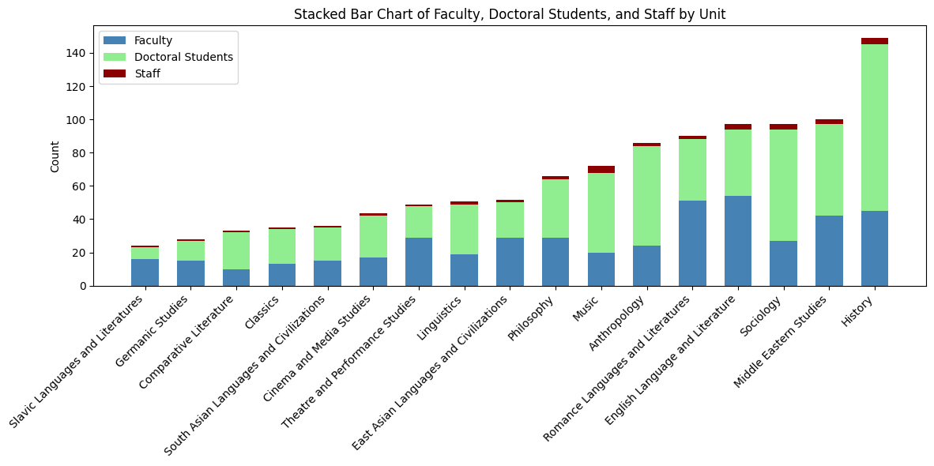

Slide 16
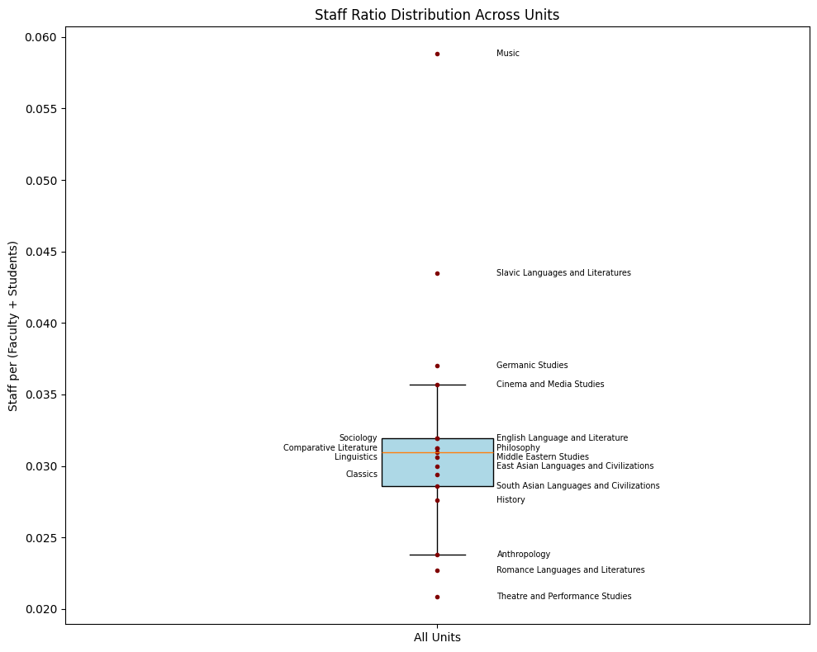

Slide 17
Faculty Hires

Slide 18
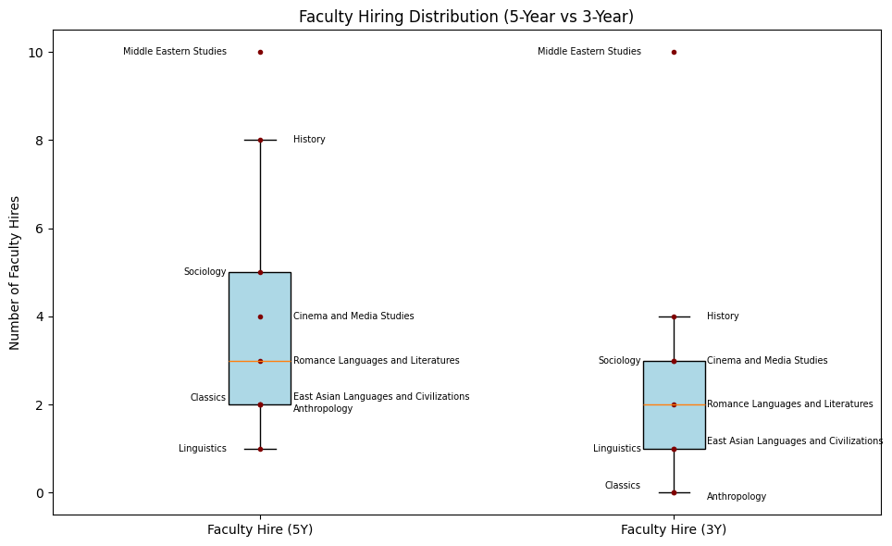
* Excluding departments with no confirmed data on recent faculty hires

Slide 19
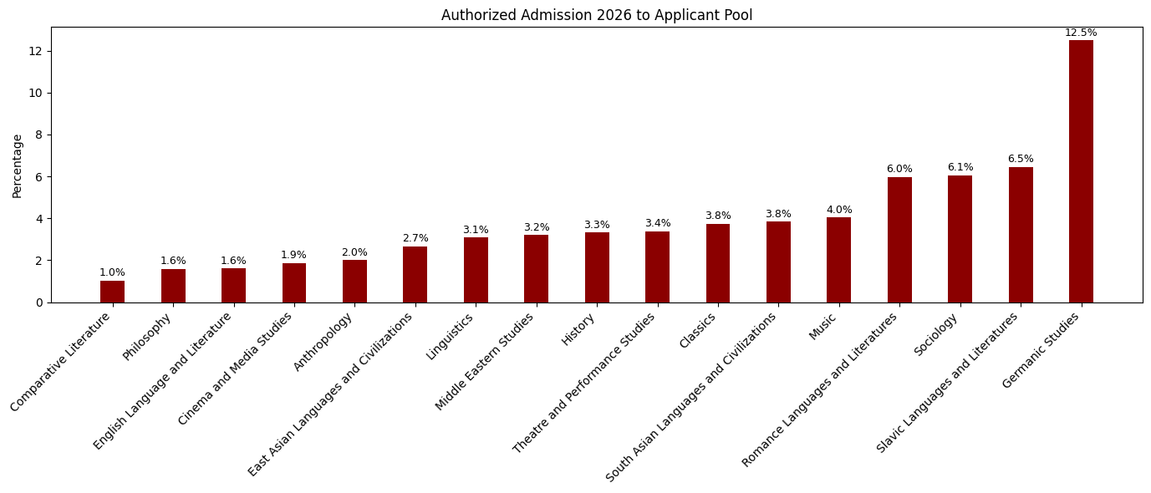

Slide 20

Facilities
The True Measure of Institutional Inequality
Faculty Lounge, Student Lounge, Kitchenette, Copy machine, Scanner,...

Slide 21
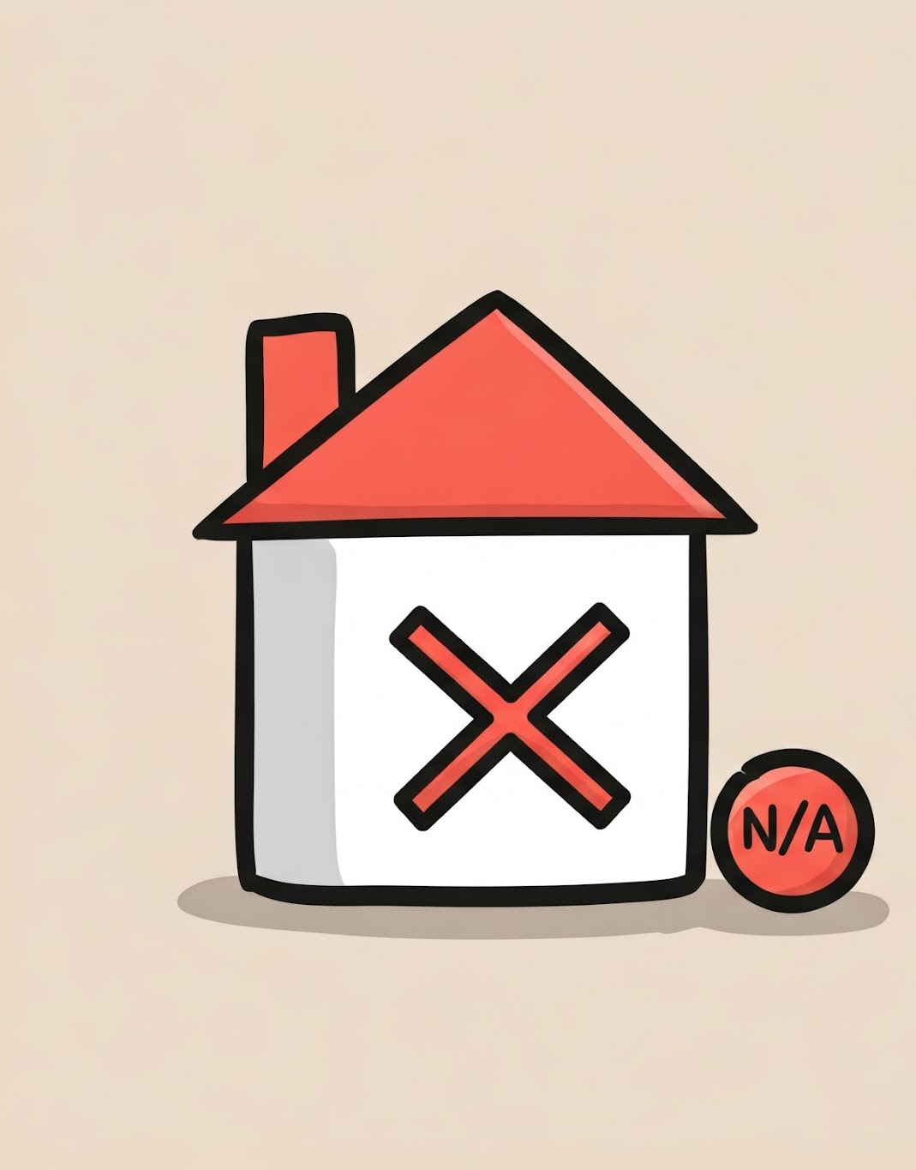
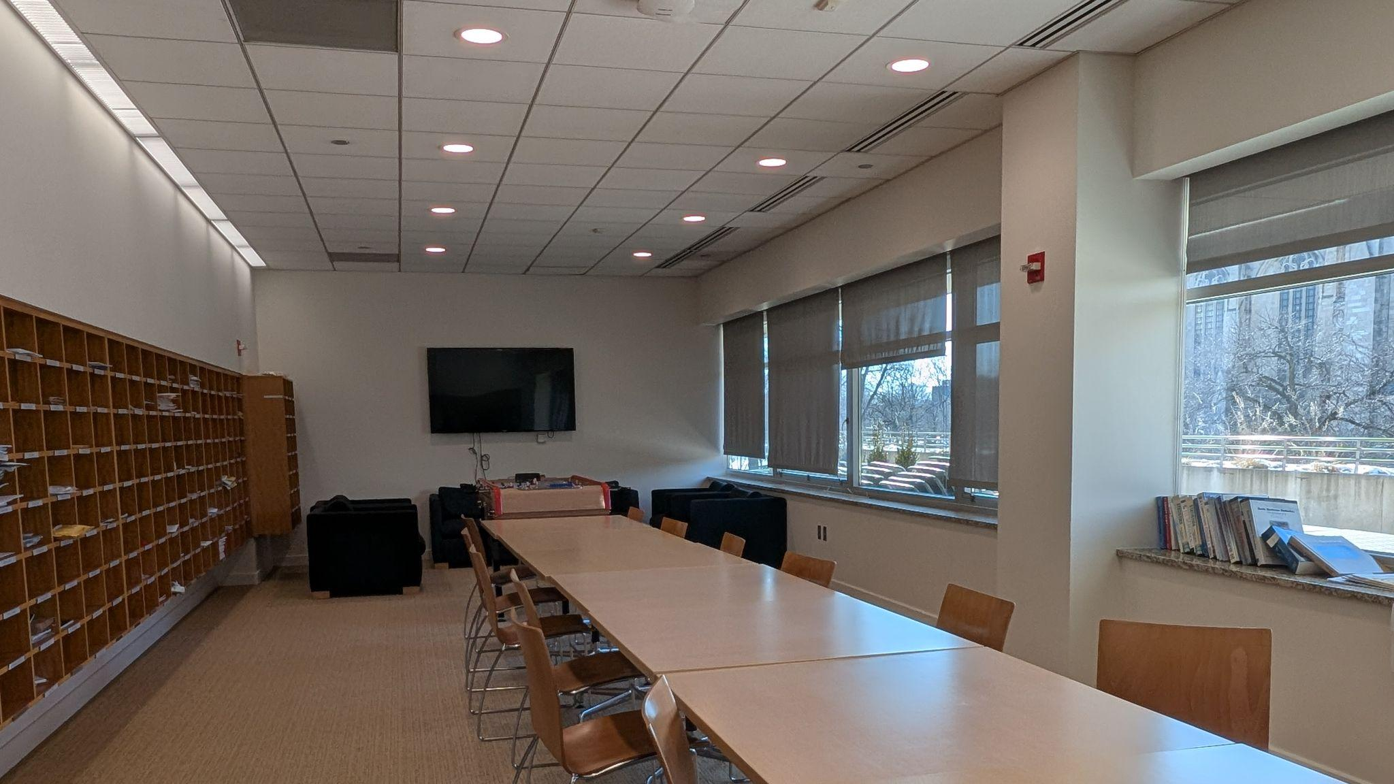
Faculty Dining Space at the Institute for the Study of the Ancient Cultures, Middle Eastern Studies
Faculty Dining Space at Booth School of Business

Slide 22
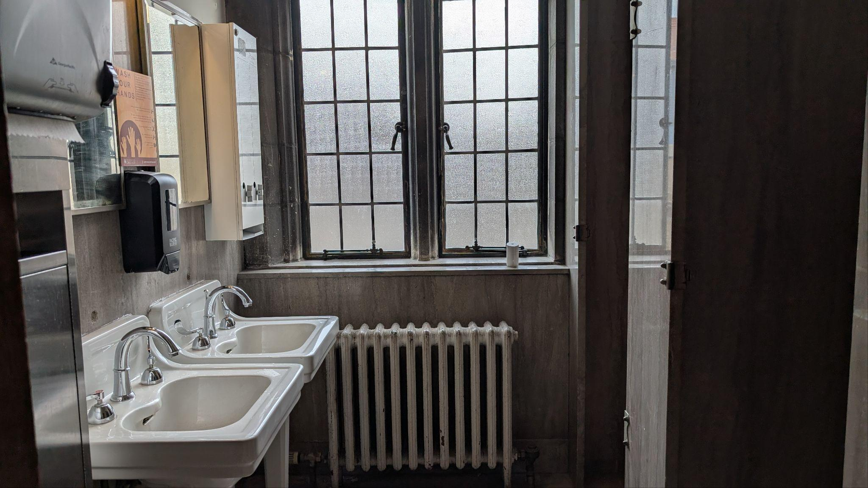
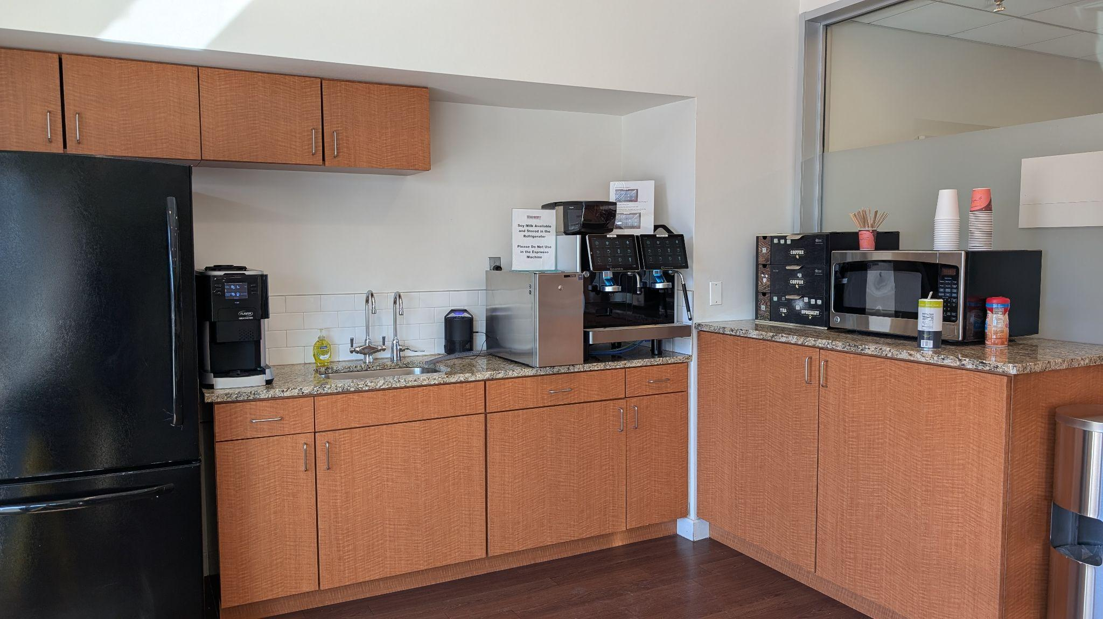
Faculty Kitchenette at the Institute for the Study of the Ancient Cultures, Middle Eastern Studies
Faculty Kitchenette at Booth School of Business

Slide 23
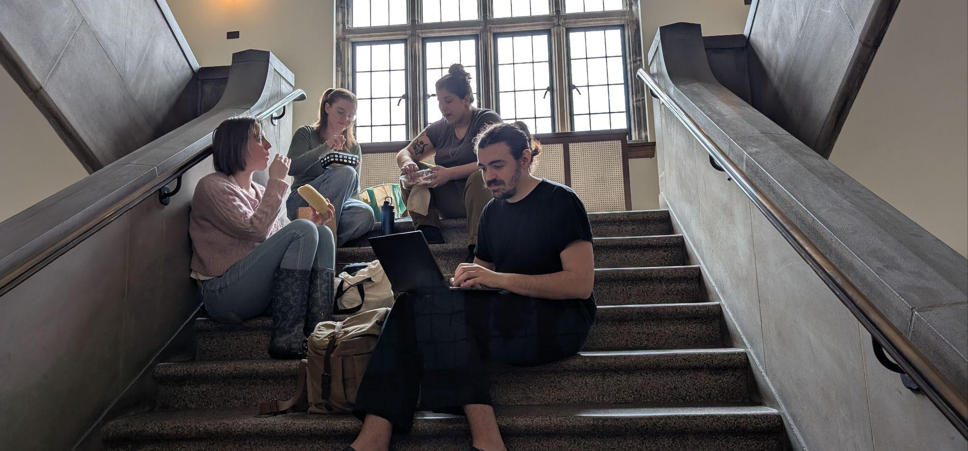
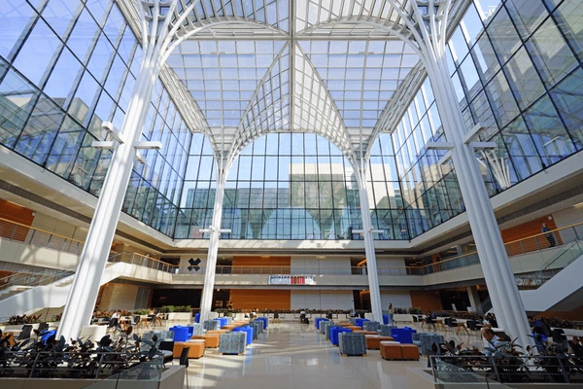
Student Social Spaces at the Institute for the Study of the Ancient Cultures, Middle Eastern Studies
Student Social Spaces at Booth School of Business

